Slide 1
Cse472 term project
“X-ray” shader

Slide 2
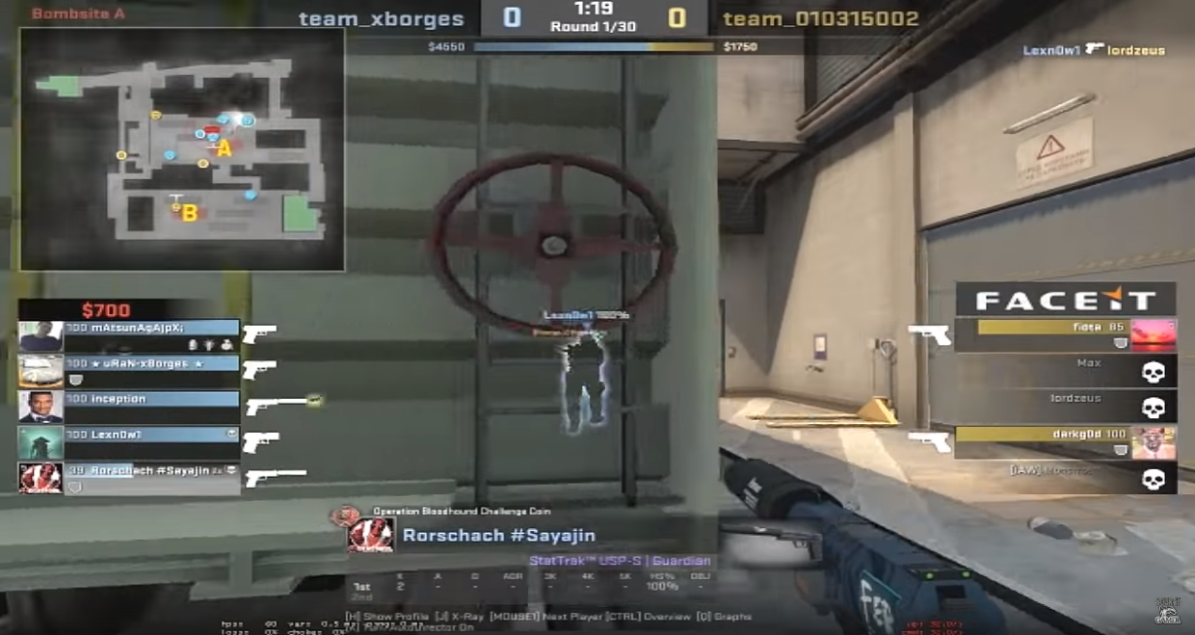

Object covered by color when they are behind other objects. That’s the shader we want to make.

Slide 3
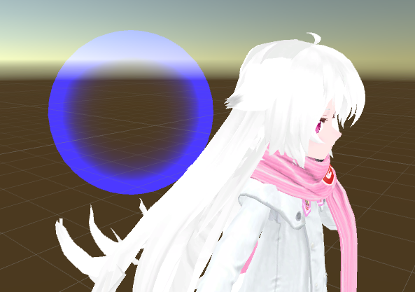

“X-ray” shader.(It only replaced the texture of object, no real x-ray effect here)

Slide 4
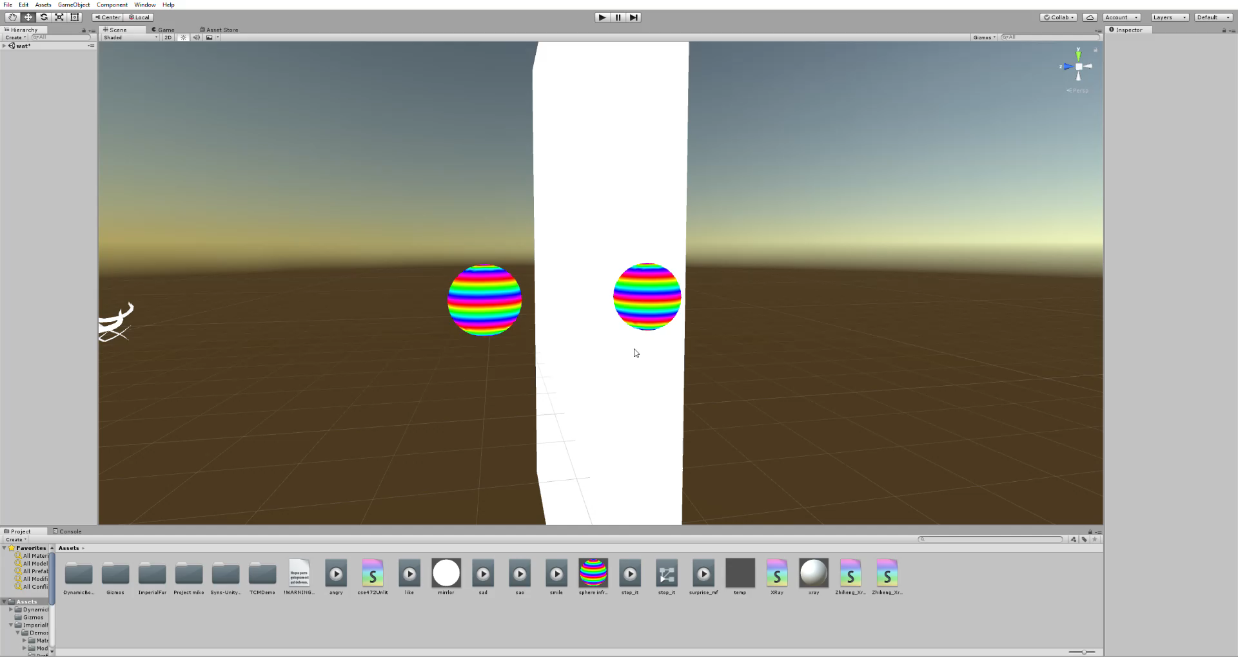
“Mirror” Shader

Slide 5
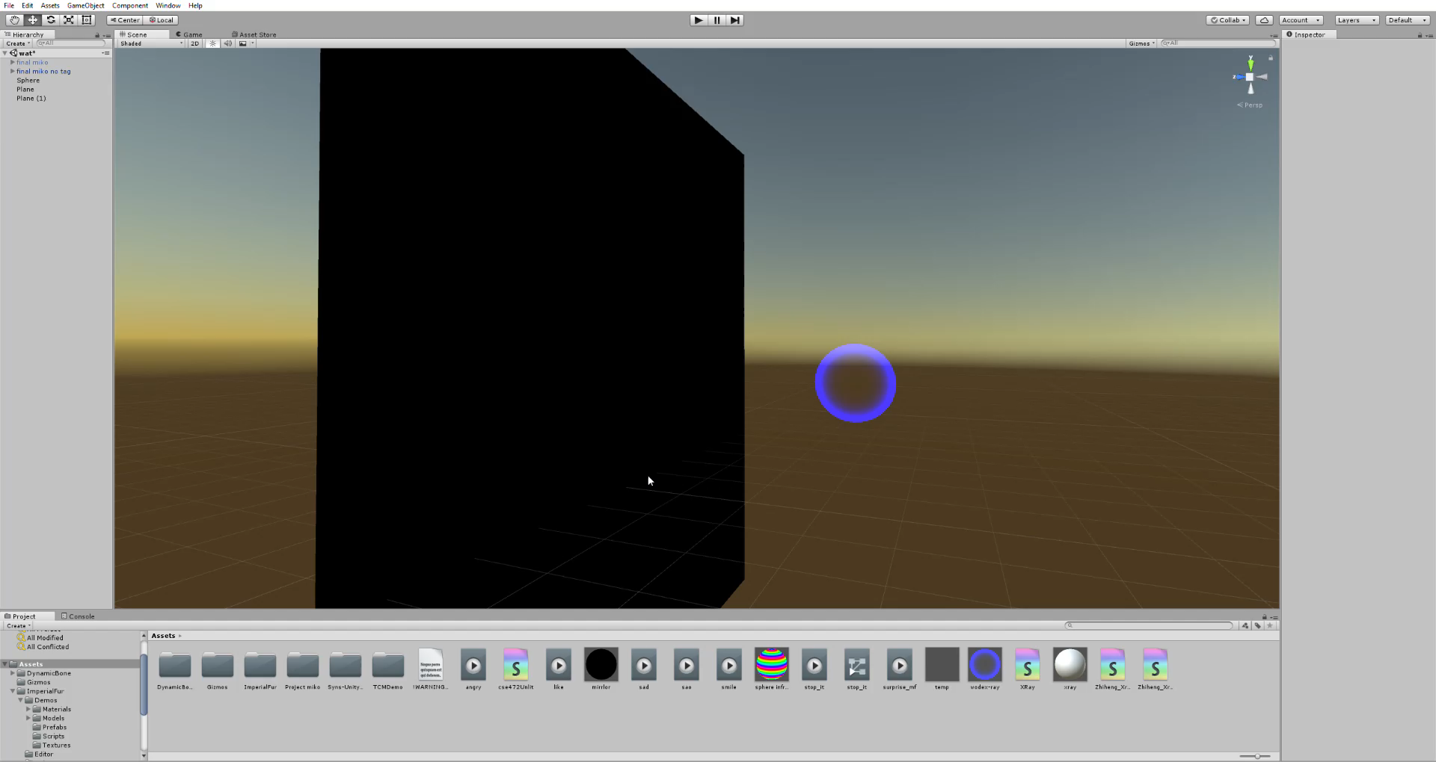
“x-ray” with x-ray effect

Slide 6
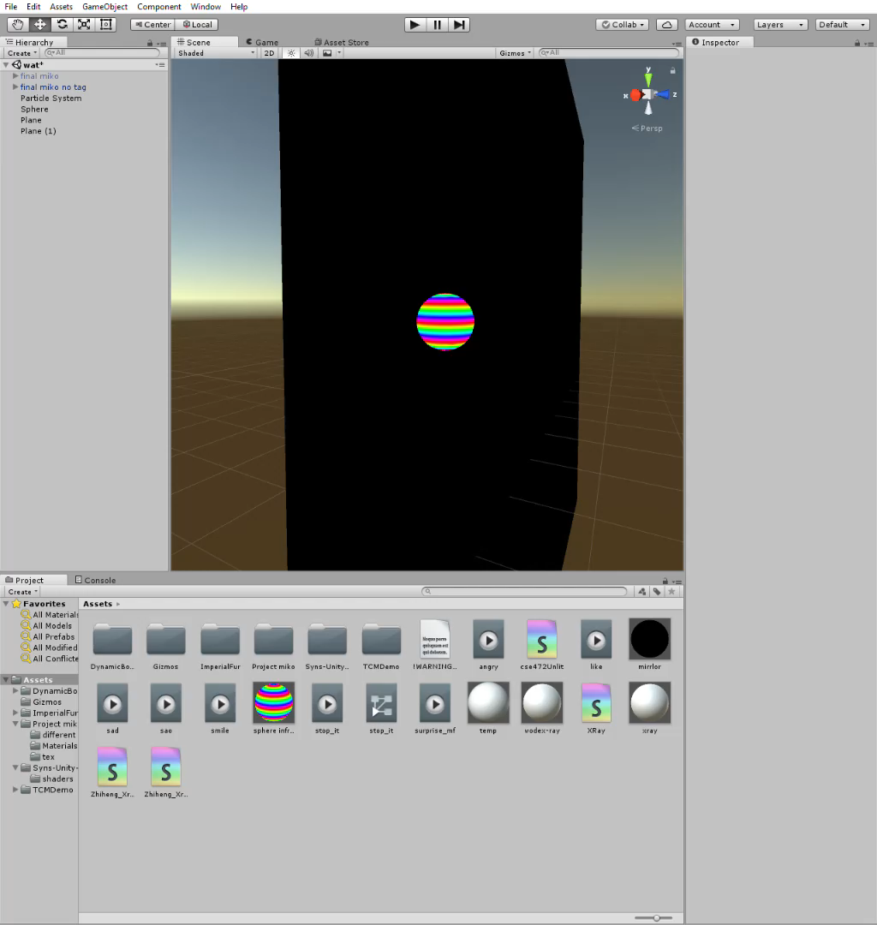
“X-ray” but still using normal texture

Slide 7
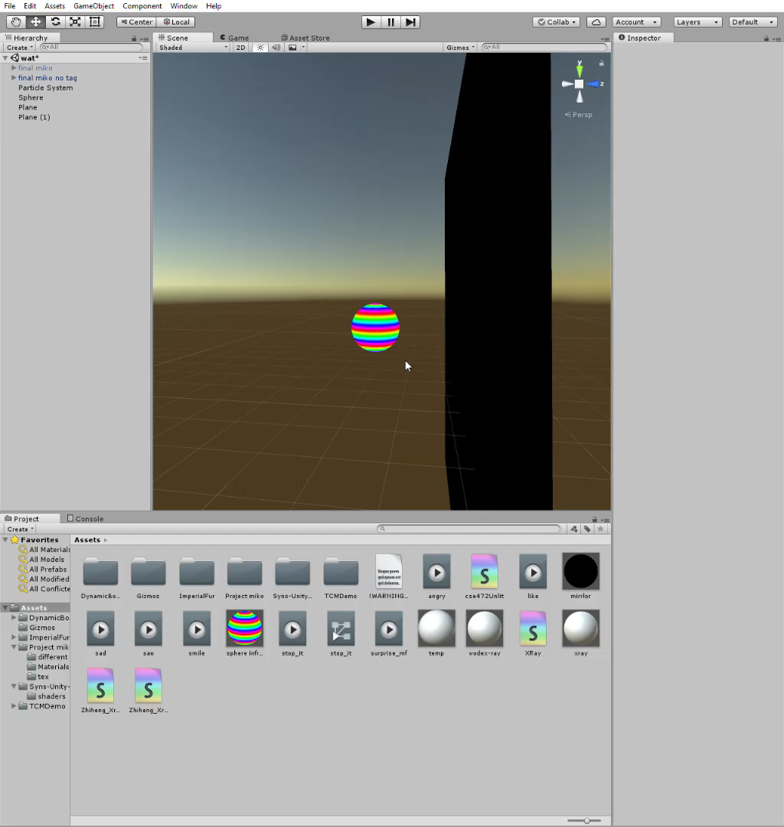
Real X-ray Shader

